Slide 1

DEPARTMENT OF ELECTRONICS
AND COMMUNICATION ENGINEERING
SUBJECT : DESIGN THINKING
SUBJECT CODE : AECC17
MOTION SENSOR LIGHT
TEAM : IDEA INCUBATORS
1) EESHA KULKARNI (1MS24EC047-T)
2) JEEVAN S (1MS24EC034-T)
3) JIYA AGRAWAL (1MS24EC055-T)
4) K ARUN KUMAR RAO (1MS24EC117-T)

Slide 2
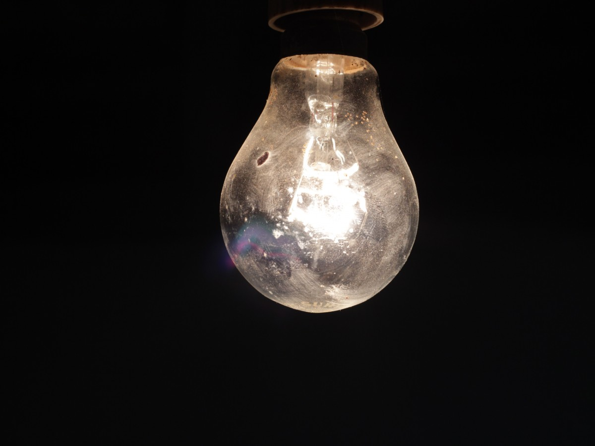
INTRODUCTION
Motion sensor lights are innovative and energy-efficient lighting solutions designed to automatically activate illumination in response to movement within a specified area. These systems are widely used in residential, commercial, and industrial settings for purposes ranging from convenience and safety to security and energy conservation.

Slide 3
How does solving this problem benefit us?
Convenience: Provides automatic lighting without the need for manual switches.
Safety: Ensures well-lit pathways and entry points, reducing the risk of accidents.
Security: Deters intruders by illuminating dark areas upon detecting motion.
Energy Savings: Minimizes electricity usage by only lighting areas when they are occupied or when motion is detected.

Slide 4

EMPATHY PHASE

Slide 5
TARGET USERS
Homeowners
Apartment Complex Managers
Commercial Property Owners and Managers
Industrial and Warehouse Operators
Retail and Hospitality Businesses
Educational Institutions
Hospitals and Healthcare Facilities
Government and Public Buildings

Slide 6

INTERVIEW
Can you describe your current lighting setup? What are some challenges you face with it?
Answer: "My current lighting setup includes traditional light switches for all the indoor and outdoor lights. One major challenge is forgetting to turn off the lights, which leads to high energy bills. Also, it can be inconvenient to find the light switch in the dark, especially in hallways and staircases.“
2. How important is security to you in your home or workplace? Have you experienced situations where better lighting could have helped improve security?
Answer: "Security is very important to me. There have been instances where having better lighting could have prevented intrusions or at least made me feel safer. Dark areas around my home, like the backyard and driveway, feel risky, especially at night."

Slide 7
3. How concerned are you about energy consumption in your lighting system? Do you take any measures to reduce energy usage, and if so, what are they?
Answer: "I am very concerned about energy consumption. I try to use energy-efficient bulbs and remind my family to turn off lights when they are not in use. However, this isn't always effective, and sometimes lights are left on accidentally.“
4. Have you ever installed or used motion sensor lights before? If so, what was your experience like? Were there any difficulties or frustrations?
Answer: "I have installed motion sensor lights before, mainly for outdoor areas like the garage and front porch. The experience was mostly positive, but I did face difficulties with adjusting the sensitivity and the duration the light stays on. Sometimes, the sensor would detect false positives, like small animals, which was frustrating.“

Slide 8
5. What features would you find most beneficial in a motion sensor light (e.g., adjustable sensitivity, duration settings, integration with other smart devices)? Why are these features important to you?
Answer: "I would find adjustable sensitivity and duration settings very beneficial, as they allow customization based on specific needs and areas. Integration with other smart devices would also be great for creating a connected home system. These features are important because they provide flexibility and control, ensuring that the lighting system is both effective and energy-efficient."

Slide 9
OBSERVATION
KEY ASPECTS TO OBSERVATION INCLUDES:
Current Lighting Solutions
User Interaction
Pain Points
Behavioral Patterns
Environmental Factors

Slide 10
Homeowners: Notice that homeowners often struggle to find light switches in the dark, leading to safety concerns and inconvenience. They also forget to turn off lights, resulting in high electricity bills.
Apartment Complex Managers: Observe that common areas like hallways and parking lots are often either over-lit or poorly lit, causing both energy wastage and security issues.
Commercial Property Owners: Note that office buildings have areas that remain lit even when unoccupied, leading to unnecessary energy consumption.
Warehouse Operators: See that warehouses need consistent lighting for safety, but lights are often left on even when the area is not in use, leading to high operational costs.
Public Buildings: Identify that public areas like parks and restrooms require adequate lighting for safety, but the current systems do not always provide sufficient illumination.

Slide 11
(PAIN POINTS):-
Inconsistent Detection:
False Positives: Motion sensors sometimes activate the light due to non-human movements like small animals, leaves, or environmental changes.
Missed Detections: The sensor may fail to detect motion in certain conditions, such as extreme temperatures or if the movement is too slow.
2. Energy Consumption:
High Energy Bills: Users often forget to turn off lights, leading to increased energy usage and higher electricity costs.
Inefficient Lighting: Lights remain on for longer than necessary, especially in areas that are infrequently used.
3. Installation and Maintenance:
Complex Installation: Users find it challenging to install motion sensor lights, especially if the setup requires wiring or technical adjustments.
Maintenance Issues: Frequent maintenance is needed to ensure the sensors and lights are functioning correctly, which can be time-consuming and costly.

Slide 12
4. Limited Customization:
Fixed Settings: Users are frustrated by the inability to adjust sensor sensitivity, light duration, and coverage area according to their specific needs.
Lack of Integration: Difficulty in integrating motion sensor lights with other smart home devices and systems.
5. Security Concerns:
Insufficient Lighting: Poorly lit areas pose security risks, making it difficult to detect intruders or navigate safely in the dark.
Delayed Response: Delays in the sensor response time can reduce the effectiveness of the lighting system in preventing security breaches.
6. Durability and Reliability:
Environmental Factors: Motion sensors and lights may not perform well in harsh weather conditions or extreme temperatures.
Component Failures: Users experience issues with sensor malfunctions or light bulb failures, leading to inconsistent performance.

Slide 13

WHAT DOES THE USER SAY?
“I often forget to turn off the lights.
“My energy bills are too high because of the lights.”
“The lights don't always detect motion accurately”
EMPATHY MAP
WHAT DOES THE USER DO?
"I adjust or manually override settings frequently.“
"I install additional lighting in poorly lit areas."

Slide 14

DEFINE PHASE

Slide 15

PROBLEM STATEMENT
Design and develop a motion sensor light prototype that automatically turns on a light when motion is detected within a specified range and turns off after a set period of inactivity. The system should be energy-efficient, cost-effective, and easy to install in residential or commercial settings.
This Photo by Unknown Author is licensed under CC BY-SA

Slide 16
“HOW MIGHT WE FORM”:
How might we create a motion sensor light prototype that efficiently detects motion within a specified range, automatically illuminates the area, and turns off after a set period of inactivity, while ensuring the system is energy-efficient, cost-effective, and easy to install in both residential and commercial settings?
By framing the problem statement in this way, we invite creative solutions and innovative approaches to address the challenge effectively

Slide 17
IDEATE PHASE

Slide 18


1. Customizable Sensitivity Settings
Idea: Develop a motion sensor light with adjustable sensitivity settings to accommodate various environments and user preferences.
Benefit: Users can fine-tune the sensor to detect movement accurately, reducing false positives and missed detections.
2. Integration with Smart Home Systems
Idea: Design the motion sensor light to integrate with popular smart home systems (e.g., Alexa, Google Home).
Benefit: Users can control and monitor the light through their smart devices, enhancing convenience and automation.

Slide 19


3. Solar-Powered Motion Sensor Light
Idea: Create a solar-powered version of the motion sensor light for outdoor use.
Benefit: Harnessing solar energy reduces electricity costs and makes the system environmentally friendly.
4. Enhanced Security Features
Idea: Incorporate additional security features, such as an alarm or notification system, that activates when motion is detected.
Benefit: Provides an added layer of security, alerting users to potential intruders in real-time.

Slide 20


5. Compact and Aesthetic Design
Idea: Focus on creating a sleek, compact, and aesthetically pleasing design for the motion sensor light.
Benefit: Ensures the light blends seamlessly with various interior and exterior decors, enhancing user satisfaction.
6. Long-Range Detection
Idea: Equip the motion sensor light with a long-range detection capability to cover larger areas effectively.
Benefit: Ideal for expansive spaces like parking lots, warehouses, and large yards, providing comprehensive coverage.

Slide 21


7. Multi-Sensor Integration
Idea: Combine multiple sensors (e.g., PIR, microwave) to improve detection accuracy and reliability.
Benefit: Reduces the likelihood of false positives and ensures the light activates only when necessary.
8. User-Friendly Installation Kit
Idea: Include an installation kit with clear instructions and all necessary components for easy setup.
Benefit: Simplifies the installation process, making it accessible to users with varying technical skills.

Slide 22
PROTOTYPE
Our motion sensor prototype is designed using a breadboard, jumper wires, an Arduino board, a PIR motion sensor, and an LED. We connected the components to create a circuit where the PIR sensor detects motion and sends a signal to the Arduino board. The board then processes the signal and activates the LED, demonstrating the motion detection functionality. This setup showcases a simple yet effective implementation of motion-sensing technology using readily available components.

Slide 23
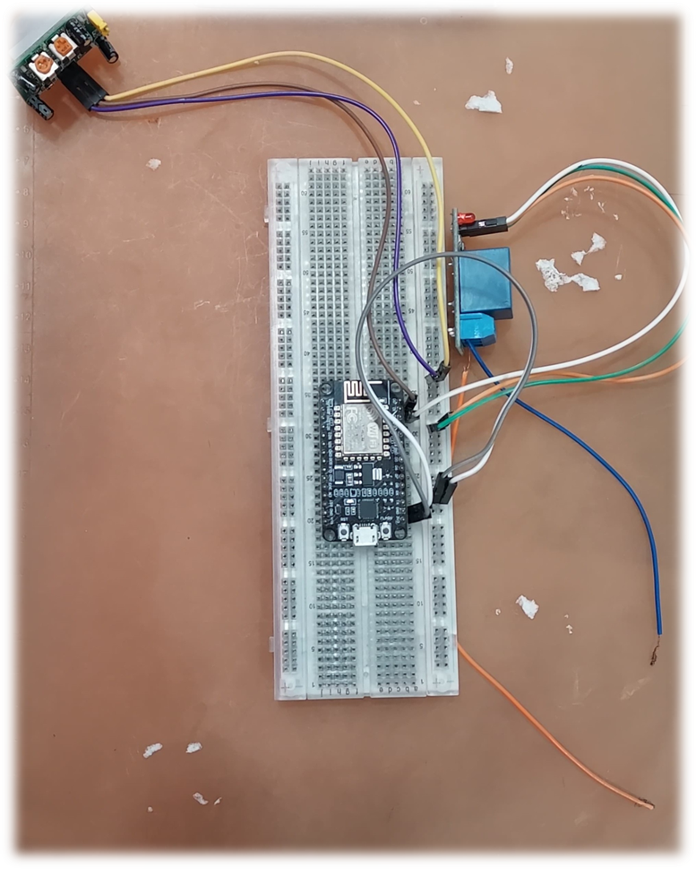

Slide 24

CONCLUSION
Creating a motion sensor light prototype means addressing user needs and solving their pain points. We learned that users often struggle with high energy bills, complex installations, and inconsistent detection.
In the ideation phase, we came up with innovative solutions like adjustable sensitivity settings, solar power, and smart home integration.
The goal is to design a reliable, energy-efficient, and easy-to-install motion sensor light that automatically turns on with motion and off after inactivity, providing convenience, safety, and energy savings.
By focusing on these aspects, we aim to deliver a practical and user-friendly lighting solution.

Slide 25
REFERENCES
https://circuitdigest.com/microcontroller-projects/how-to-build-pir-motion-sensor-light
https://www.instructables.com/PIR-sensor-with-LED-for-Beginners/
Wikipedia
Design Thinking in the classroom by David Lee
https://forum.arduino.cc/t/motion-sensor-that-lights-a-led/1156262

Slide 26

THANK YOU FOR LISTENING!!

